Slide 1
Modeling and simulation of atrazine biodegradation in bacteria and its effect in other living systems
Name: Shouvik Banerjee Argha
ID: 20301118

Slide 2
Table of Contents:
Introduction
Materials and methods
Results
Discussion
Conclusion

Slide 3
1.Introduction
Atrazine Overview:
Triazine-class herbicide widely used in global agriculture for weed control.
Known for persistence, adverse effects, and disruption of endocrine receptors.
Global Usage:
Despite the EU ban in 2004, extensively used in the USA, Australia, and other regions.
Environmental Impact:
Focus on the environmental consequences of atrazine.
Emphasis on the need for effective removal methods.
Biodegradation Importance:
Stresses the importance of biodegradation over physicochemical methods.
Highlights microbial techniques as eco-friendly and cost-effective.
Microbial Strains:
Various strains identified, e.g., Arthrobacter aurescens and Metarhizum.
Microbial degradation involves enzymatic pathways; genes responsible for atrazine catabolism discussed.

Slide 4
Residual Concentration Concerns:
Emphasizes the increasing residual concentration of atrazine due to widespread agricultural use.
Biomagnification and Impacts:
Notes concerns about biomagnification with potential impacts on humans, plants, and soil systems.
Advanced Techniques:
Highlights the significance of advanced techniques (e.g., next-generation sequencing, systems biology).
These techniques aid in studying atrazine degradation and its effects.
Research Objectives:
Aims to contribute to a comprehensive understanding of microbial system biology in atrazine degradation.
Utilizes simulation and modeling for molecular insights and bioremediation strategies in complex environments.

Slide 5
2. Materials and methods
2.1 Establishment of the model
1.Literature Exploration:
Comprehensive review of previous literature exploring connections between atrazine, bacteria, weeds, soil, atmosphere, and human systems.
2.Biochemical Model Development:
Utilized System Biology Graphical Notation (SBGN) for creating a biological network (see Figure 1).
Atrazine biodegradation pathways in bacteria, insects, and humans constructed using Cell Designer 4.4.
3.SBML Format:
Pathways stored in Systems Biology Mark-up Language (SBML), a machine-readable format for expressing biological networks.

Slide 6
4.Cell Designer Features:
Cell Designer platform used with a graphical user interface.
Components include DNA, RNA, proteins, catalysis, stimulation, inhibition, phosphorylation, degradation, activation, transcription, and translation.
5.Pathway Simulations:
SBML ODE solver and Copsai tools within Cell Designer employed for pathway simulations.
Enables quantitative analysis, simulation, and determination of key parameters.

Slide 7
2.2 Kinetic rate equations
1.SBML Squeezer 2.1 for Kinetic Rate Predictions:
Used SBML Squeezer 2.1 in Cell Designer to predict kinetic rate reactions in the model (DrEager et al., 2015).
2.Advantages of Cell Designer for Rate Equations:
Simplifies and ensures errorless assignment of rate equations.
Utilizes SBGN representation data for all atrazine network components (Bacteria, insects, Humans).
3.SBML Squeezer and SBO Annotations:
SBML Squeezer determines Systems Biology Ontology (SBO) annotations for fetching essential data (DrEager et al., 2008; Gupta & Misra, 2013).
4.Diverse Rate Laws:
Includes various enzyme kinetics and mass action.
Generates equations for atrazine degradation using Michaelis–Menten kinetics and hill equation for single substrate reactions.
5.Complex Enzymatic Reactions:
Encompasses scenarios like irreversible reactions, di-uni and di–di enzyme reactions, and thermodynamics using kinetic modular rate laws (DrEager et al., 2015; Liebermeister et al., 2010).

Slide 8
2.3. Dynamics and simulation of the model
Dynamic Simulation Tool
ODE-Based Simulations
Widespread Application
Integration with Cell Designer
Deterministic Algorithm
Parameter Analysis
Simulation Results Presentation

Slide 9
2.4 Network analysis
1.Model Construction and Export:
Atrazine bioremediation and biomagnification model built in Cell Designer 4.4, exported to SBML format.
2.Cytoscape Utilization:
SBML format used in Cytoscape 2.8.3 via Biological Network Manager (BiNoM) plugin.
3.BiNoM Features:
BiNoM supports various system biology network formats (SBML, SBGN, BioPAX) and handles complex biological reaction networks.
4.Cytoscape Plugins:
Leveraged plugins like Network Analyzer to decode the complexity of biological networks.
5.Network Analyzer Application:
Specifically used Network Analyzer for assessing atrazine bioremediation and biomagnification effects.
6.Detailed Component Analysis:
Conducted a detailed analysis of each component within bacteria, insects, and human systems.
7.Thorough Examination:
Enabled a comprehensive examination of impact and interactions within atrazine-related biological networks.

Slide 10
3. Results
3.1. Description of constructed model
1.Atrazine Signaling Model Gap:
Absence of an atrazine signaling model in System Biology Graphical Notation (SBGN).
2.Study Goal:
Goal to understand atrazine bio-remediation through quantitative and qualitative analysis of herbicide pathways in the environment.
3.Existing Reports:
Acknowledges scientific reports on atrazine biodegradation but notes a lack of a comprehensive biomagnification pattern.
4.Research Hypothesis:
Hypothesizes both complete biodegradation and possible residual amounts in various environmental systems.

Slide 11
5.Systems Biology Approach:
Employs a systems biology approach to model molecular mechanisms, determining pathway responses and identifying key components.
6.SBGN Utilization:
SBGN used to depict relationships among molecular species based on previous studies and databases.
7.Model Characteristics:
Resulting model includes 11 compartments, 196 species, 20 proteins, 140 reactions, 12 genes, and 13 RNA, illustrated in Figure 2.

Slide 12
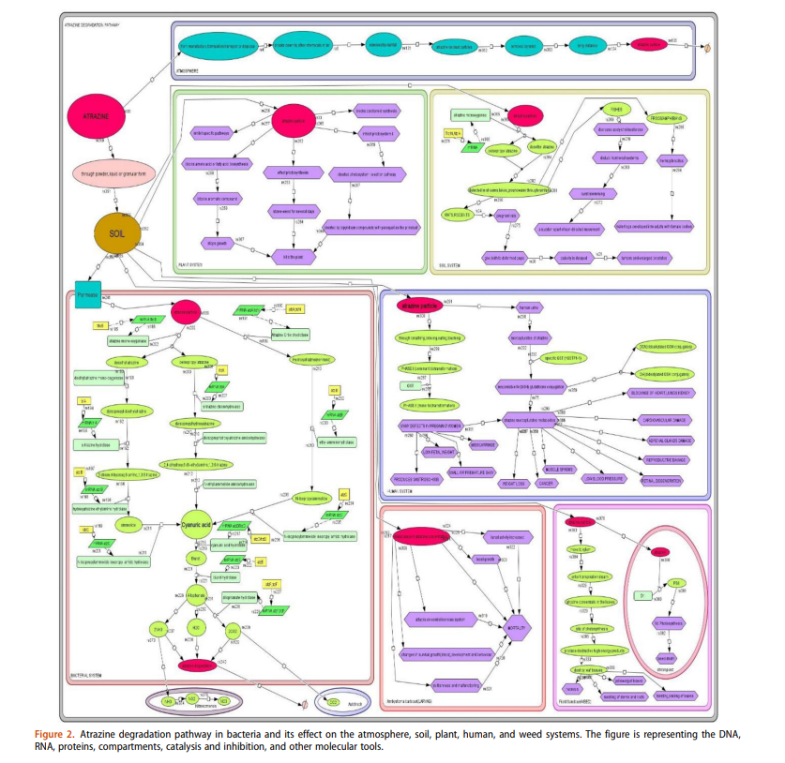

Slide 13
3.2. Dynamic behavior prediction of the constructed model through simulation analysis
1.Integrated Systems Approach:
Utilizes SBML Squeezer to predict atrazine pathway dynamics at the molecular level.
2.Simulation Setup:
Simulations run on an Intel Core i7 processor (2.40 GHz), 16GB RAM, 64-bit Windows OS.
3.Data Representation:
Lack of experimental data for individual cells, so simulations represent quantity in terms of amount.

Slide 14
4.Species Assignment:
Assigns values (1 to 10) to molecular species for simulation, including atrazine, proteins, genes, phenotypic responses, soil, permease, and enzymes.
5.Compartmentalization:
System compartmentalized into 11 components, featuring Atmosphere, Plant system, bacterial system, etc.
6.Model Characteristics:
Overall pathway includes 196 species, 20 proteins, 140 reactions, 12 genes, and 13 RNA.
7.Simulation Insights:
Highlights higher expression of chlorohydrolase and mono-oxygenase during atrazine degradation.
Correlates atrazine concentration with larval mortality.
Confirms atrazine's inhibition of photosystem protein D1 in weeds.

Slide 15
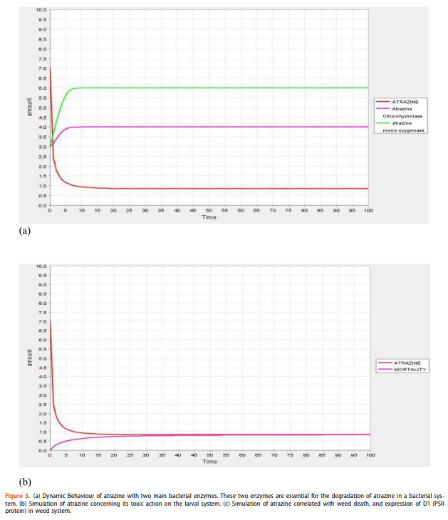
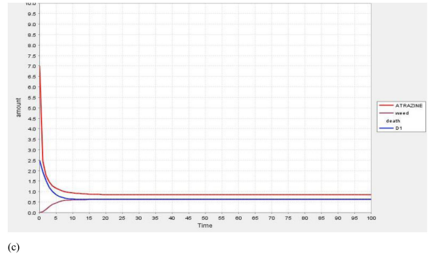

Slide 16
3.3. Topological analysis of the atrazine degradation
1.Topological Analysis:
Atrazine model from Cell Designer underwent topological analysis using Cytoscape.
Resulting network included 289 nodes and 300 edges with undirected interpretation.
2.Calculated Parameters (Table 1):
Clustering coefficient: 0.0, connected component: 1, network diameter: 41, centralization: 0.031, characteristic path length: 16.50, network density: 0.007, network heterogeneity: 0.471.
3.Visualization Style (Figure 5):
Node size based on "Degree," node color based on "Betweenness Centrality."
4.Map Insights:
Cytoscape-generated map depicted atrazine degradation and its effects on cellular systems.
Hub nodes represented by red, green, and yellow colors, indicating the importance and effects on atrazine degradation and different cellular systems.
5.Results and Insights:
Provided insights into specific degradation pathways and regulatory steps in the atrazine degradation process.

Slide 17
4. Discussion
1.Atrazine's Global Impact:
Widely used for cost-effective weed control, leading to environmental traces and risks to living systems.
2.Research Gap:
Previous studies focused on atrazine biodegradation, lacking comprehensive systems biology analysis, especially in biomagnification.
3.Study Objective:
Investigates biodegradation effects on various cellular systems, aiming to understand simultaneous interactions in the environment.
4.Bacterial Biodegradation:
Atrazine enters bacterial cells through permease, converting into desethyl and deisopropyl atrazine.
Metabolic pathways produce cyanuric acid facilitated by monooxygenases and hydrolases.
Essential genes include thcB, atzABC, and atzDEF.
Cyanuric acid converted into CO2 and NH3 by soil bacteria like Nitrosomonas, serving as nitrogen and carbon sources.

Slide 18
5.Simulation Studies:
Network summarizing atrazine degradation created through simulation studies.
Color-coded module view identifies regulatory functions, with red indicating hubs and yellow less regulatory functions.
6.Impact on Plants, Soil, and Human Health:
Atrazine negatively impacts plant systems, inhibiting metabolic pathways, amino acid biosynthesis, and disrupting photosynthesis.
In soil, it disturbs ecosystems, acts as a toxic chemical for aquatic life, and contaminates the atmosphere.
Human health effects include low fetal weight, cancer, muscle spasms, contaminated urine, and cardiovascular damage.
7.Impact on Insects and Weeds:
Insects experience mortality due to central nervous system disturbance.
Weeds suffer tissue damage, particularly in the photosystem II's D1 protein.

Slide 19
5. Conclusion
1.Research Focus:
Comprehensive systems biology analysis of atrazine degradation using modeling and simulations.
2.Objective:
Unravel the intricate biological network within different cellular systems.
3.Biodegradation Exploration:
Investigates both toxic effects of atrazine and its biodegradation using bacterial strains.
4.Key Findings:
Dynamics studies highlight the crucial role of atrazine-degrading enzymes (chlorohydrolase and monooxygenase).
Correlation emphasizes their significance in atrazine bioremediation.
5.Contributions:
Provides valuable insights into the degradation and fate of atrazine and similar toxic compounds in the environment.

Slide 20
Thank you

